Slide 1


Data Intelligence Low Code Inventory App for Personal and Corporate Settings

Slide 2


Where we fit in
Many existing food inventory management apps are designed for either business or personal use, but not both
Personal-use inventory management apps tend to lack in features, while business use ones tend to not be user friendly
There was no middle ground, where both use cases could coexist
WasteDrop is designed to not only cater to both sides, but also have them enhance each other
Having one product that fits both needs expands potential markets

Slide 3
Our team
Samual Muvdi – Lead developer
01
Edward Basulto – Developer
02
Ryan Fernandez – Project Coordinator
03
Abel Rivas –Researcher
04
David Rice - Researcher
05

Slide 4
Project Timeline
Phase 1:
Phase 1included the initial research and establishment phase. Project idea selected, frameworks/language and services chosen, basic design decisions and foundational code written
Phase 2:
Phase 2 was the primary design phase, all remaining design decision made here, large bulk of dev work done here
Phase 3:
Phase 3 continued development work and saw the creation of most test cases and testing activity with the project’s conclusion

Slide 5
Project landscape
Primary Language
Python
Development Framework
Streamlit
Database
Supabase
Source Control
GitHub

Slide 6
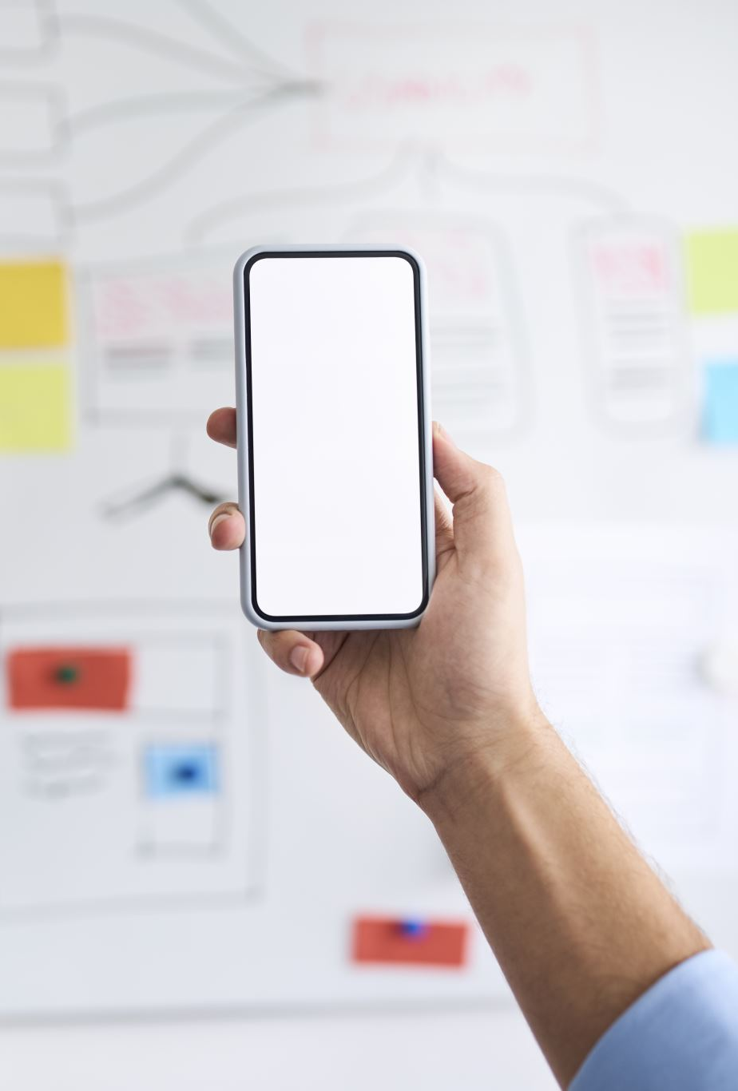
App Design Philosophy & Goals
Flexible app for both personal & business use.
Simple & Clean UI for efficient usage.
Streamlined user experience.
Creating a powerful inventory management system.
Scalability for future development.

Slide 7
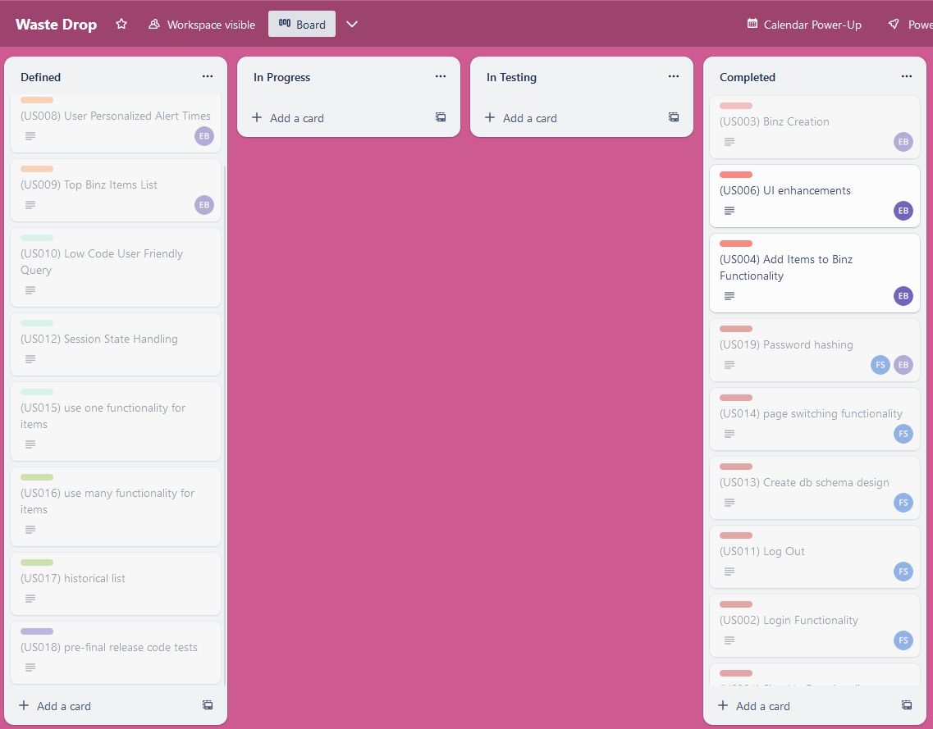
Design Strategies Incorporated
Trello Board for organization.
Streamlit – Low Code Framework.
Sprints to Distribute Work.

Slide 8
-Demonstration-
Demonstrate that the product is operational
All the product features must be demonstrated
Demonstrate that the product passes all the test cases
Demonstrate that the product resolved the project problem, gap or issue.

Slide 9
Notes (temporary)
The program should be well organized
The ideas should be presented in an order that makes sense to the audience.
The time for the presentation is well used and the presentation is not rushed, too long or too short.
Each team member should participate actively and for about the same length of time.
Presentation aids, such as a PowerPoint presentation or other audio/visual aids or media are used and add to the main ideas and themes.
You should have a reference slide at the end with all sources used for the content in the presentation. You should also cite the sources any external content that you use.

Slide 10
References

Slide 11
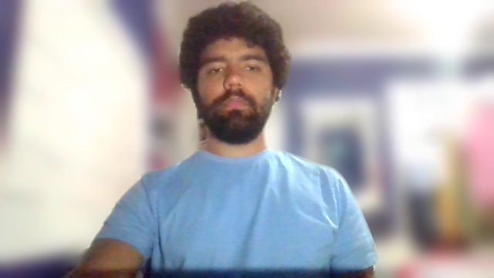
Conclusion
WasteDrop’s development resulted in a realized success, wherein we were able to bring our idea to fruition.
It is currently in a core state, capable of scalability.
With WasteDrop working as intended, the user will have an easier time using a personal-use inventory management app compared to other competitors.
Notes:
Hi! My name is Abel. As I was tasked with research for WasteDrop, I will be concluding our presentation. In conclusion, WasteDrop's development has turned out to be a success! We were able to develop the app as we initially intended, getting the essential features of inventory management down. Currently, the app is in a core state, boasting scalability as one of its key features. WasteDrop, in its intended functionality, ensures that users experience a smoother and more intuitive process in managing personal inventories, setting it apart from other competitors. We’ve overcome a few challenges and have learned many lessons in the WasteDrop app’s development.

Slide 12
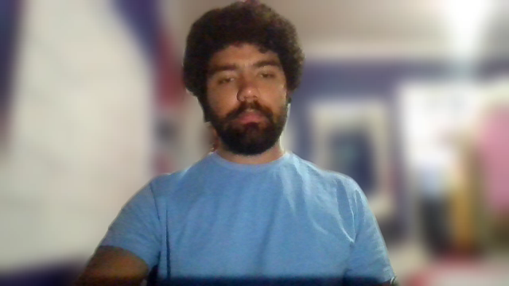
teamwork
In playing key roles in the development of WasteDrop, we led our efforts, ensured code quality, managed the entire stack, and oversaw various project aspects. Our development and back-end operations expertise were pivotal in scripting Python and ensuring seamless data operations. Coding and testing were carried out collectively, underscoring our shared commitment. Use case verification through testing and valuable research assistance were integral to our collective efforts. Meticulous project organization and transparent documentation were maintained throughout, marking progress and deliverables.
Notes:
As instrumental contributors to WasteDrop's development, we assumed key roles, leading our efforts, maintaining code quality, and overseeing the entire project stack. The team’s expertise in development and back-end operations played a crucial role in scripting Python and ensuring flawless data operations. The collaborative coding and testing process highlighted our shared commitment to excellence. Our collective efforts included essential tasks such as use case verification through testing and valuable research assistance. Throughout the project, we upheld meticulous organization and transparent documentation, effectively marking progress and deliverables.

Slide 13
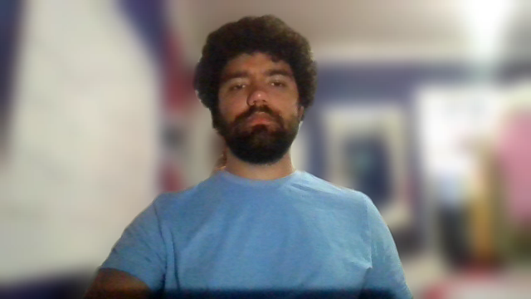
Key takeaways
Challenges | Learnings
Streamlit implementation | Stored cached information made it difficult for Streamlit to handle multiple accounts. Psycopg2 was used to allow it to connect to Supabase.
Ionic implementation | Although Ionic stands as a platform for web development, its lack of mobile support made it difficult to go forward with development and its intended future.
Flask implementation | Flask was considered due to its ease of use and integrated unit testing system, but it was not utilized due to no support for multi-page
Notes:
In implementing Streamlit, we learned that storing cached information made it difficult for Streamlit to handle multiple accounts. Psycopg2 was used to allow it to connect to Supabase. Ionic’s implementation was a process of trial and error. Although Ionic stands as a platform for web development, its lack of mobile support made it difficult to go forward with development and its intended future. Lastly, Flask was only considered, but never truly implemented. Its ease of use and integrated unit testing system could have come in handy, but we did not go forward with it due to a lack of support for multi-page functionality.

Slide 14

Future enhancements
WasteDrop is currently only available as a web browser application. There will be plans to port it over for mobile Android and iOS usage, as originally intended.
Plans to implement reminders concerning expiration dates, practical tips on food storage and usage.
UI enhancements
Notes:
As it stands, WasteDrop is currently only available as a web browser application. We plan to port it over for mobile Android and iOS usage, as originally intended. There are also plans to implement reminders concerning expiration dates, practical tips on food storage and usage to be pulled from online sources. Furthermore, we also plan on implementing UI enhancements in order to streamline user experience.

Slide 15


Thank you!

